Slide 1
Functions
Module 12

Slide 2
Function Definitions

Slide 3
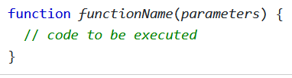
Functions Declarations
Declared functions are not executed immediately
Declared functions are saved for later use, only to be run when they are called
Use the following syntax:

Slide 4
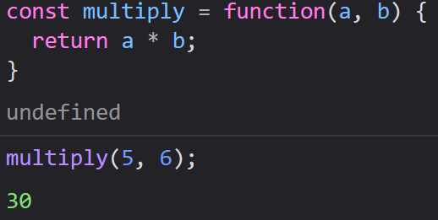
Functions Expressions
Functions can also be defined using an expression
This allows us to store our functions inside of a variable
After a function is stored in a variable, that variable can be used as a function

Slide 5
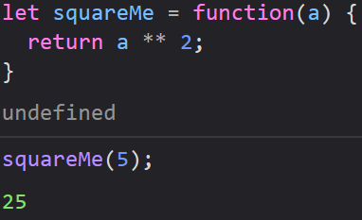
Function Expressions
Functions that are stored inside of variables do not need to be named, hence they are anonymous functions.
We are able to call these functions using their variable name

Slide 6


The Function() Constructor
Generally, we want to define our functions like normal, inside of curly braces.
Its also possible to use function’s constructor to define a function as well
Both methods are possible, but its much quicker and easier to define functions using curly braces

Slide 7
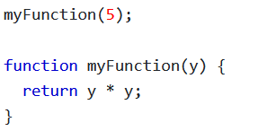
Function Hoisting
Just like variables, JavaScript will move (hoist) function declarations to the top of their scope when you run your code
This allows JavaScript functions to be used before they are declared
This does not apply to function expressions

Slide 8
Self-Invoking Functions
These functions start automatically without being called
Function expressions will execute automatically as long as they are followed by a set of parentheses
Function declarations normally cannot be self-invoked

Slide 9
Self-Invoking Functions
To self invoke a function declaration (a normal function), you must put parentheses around it, then follow it with parentheses
These functions are often anonymous functions as well
Self-Invoking Functions are sometimes referred to as IIFEs, or Immediately Invoking Function Expressions

Slide 10
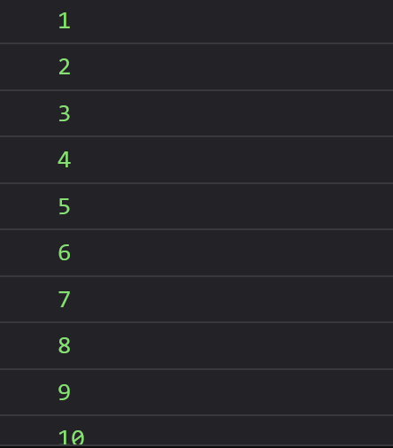
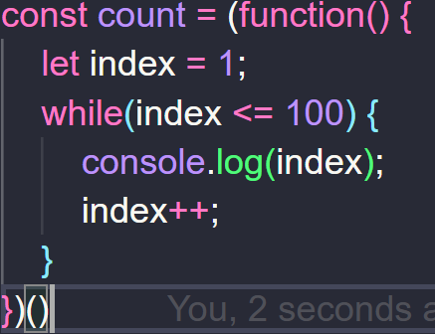

Slide 11
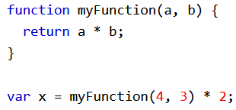
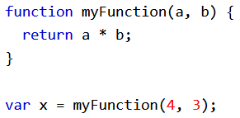
Functions as Values
Like we saw, we can (and often do) use function calls as values
Additionally, its very common to use functions inside of larger expressions

Slide 12
Functions as Objects
When we use typeof on a function, JavaScript will return “function”
However, JavaScript functions are defined as Objects
JS Functions have both properties and methods, including the arguments.length property and the toString() method

Slide 13
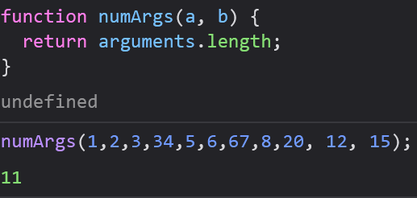
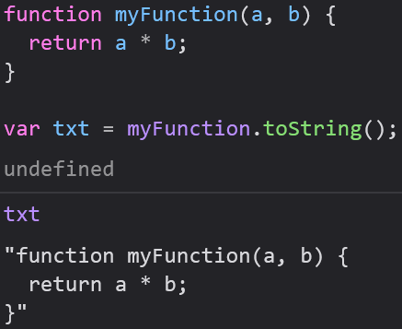
Functions as Objects
arguments.length returns the number of arguments received when the function was called
toString() returns your function as a string

Slide 14


Arrow (Lambda) Functions
Arrow functions let you omit function and return keywords as well as the curly braces of a function
Arrow functions are never hoisted, so they must be defined before they are used
return and the curly braces can only be omitted if the function is a single line

Slide 15
Function Parameters

Slide 16
Parameters and Arguments
Although parameter and argument are often used interchangeably there is a difference between them
Parameters: the names listed in the function definition
Arguments: the values passed into (and received by) the function

Slide 17
Parameter Rules
Unlike many other languages, JavaScript’s function definitions do not specify the data type of its parameters
JavaScript will not check the type of parameters, meaning that we must check their type on our own
JavaScript functions also will not check the number of arguments received

Slide 18

Default Parameters
If a function is called with fewer arguments than the number of parameters that were declared, the missing values are set to undefined
This can cause lots of different problems, so we can avoid this by assigning a default parameter
Syntax:

Slide 19
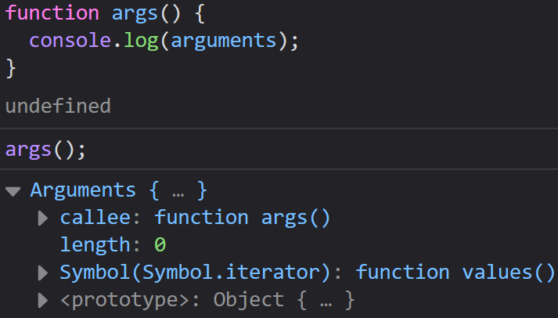
The Arguments Object
JS Functions have a built in arguments object
It contains an array of all arguments passed to the function when it was called
This where we got arguments.length from earlier

Slide 20
Arguments: Passed by Value
Arguments get passed by value, meaning the function only sees the values, but not where they came from
If a function changes an argument’s value, it does not change the parameters original value
Changes to arguments are not visible (reflected) outside the function

Slide 21
Objects: Passed by Reference
Objects are passed by reference, meaning the function has access to the original object, not a copy of it.
If a function changes an object’s property, that property is permanently changed
Changes to object values are visible (reflected) outside the function

Slide 22
Function Invocation

Slide 23
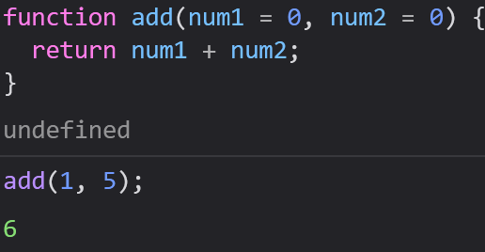
Invoking a JavaScript Function
Functions do not invoke when the function is defined
In addition to saying we invoke a function, its common to say we call upon a function, start a function, or execute a function.
Technically, there is a difference between invoking and calling a function, but its negligible

Slide 24
The Global Object
When a function is called without an owner, like an object, the value of this becomes the Global Object
In a web browser, the global object is the browser window
This can change depending on where your code is running, but since we are doing Front-End Development it will be the window

Slide 25
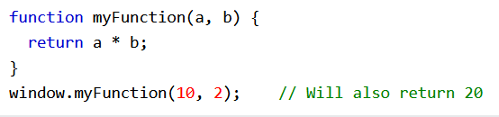
Invoking a Function as a Function
Functions belong to their global object, which will often be our browser window
Because of this, we can call our functions with the prefix window
Although we can do this, it might cause name conflicts with other global functions, so keep it to a minimum

Slide 26
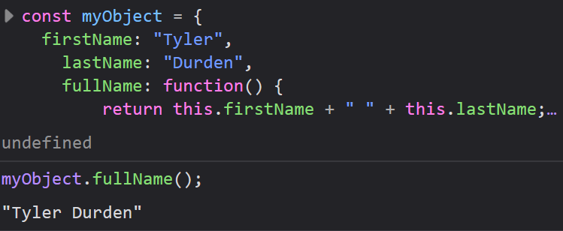
Invoking a Function as a Method
Functions can also be defined as Object methods
The function/method’s owner is always the Object that contains the function/method

Slide 27
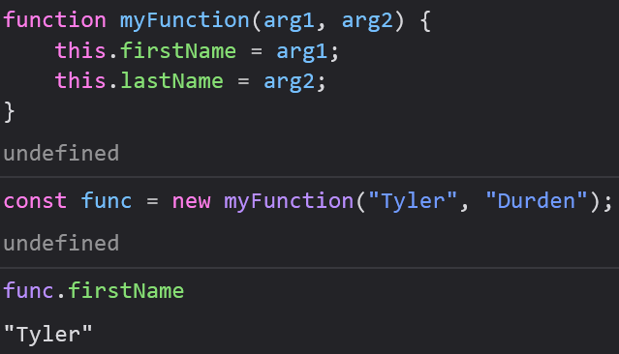
Invoking a Function with a Constructor
Any time you use the new keyword with a function, you are creating a new Object
Invoking a constructor creates a new Object which will inherit all of the properties and methods of the constructor

Slide 28
Function Call

Slide 29
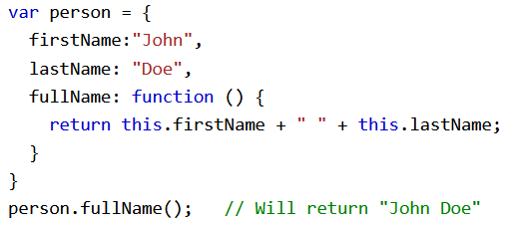
All Functions are Methods
In JavaScript, all functions are Object methods
All functions belong to an object, even if that object is the global object, which makes them methods

Slide 30
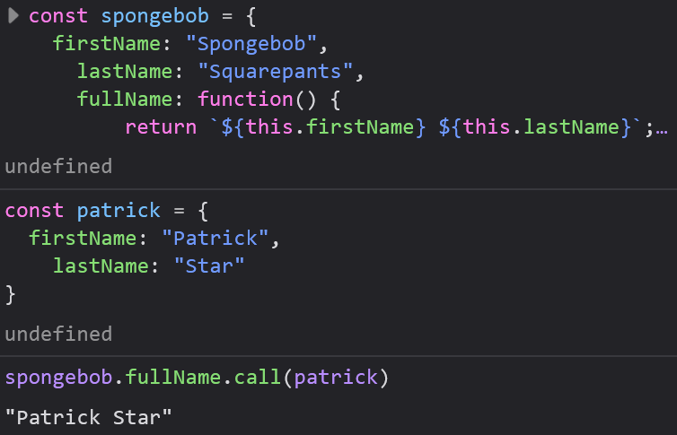
The call() Method
call() is a predefined JavaScript method
We can use call() to invoke an object’s method on another object

Slide 31
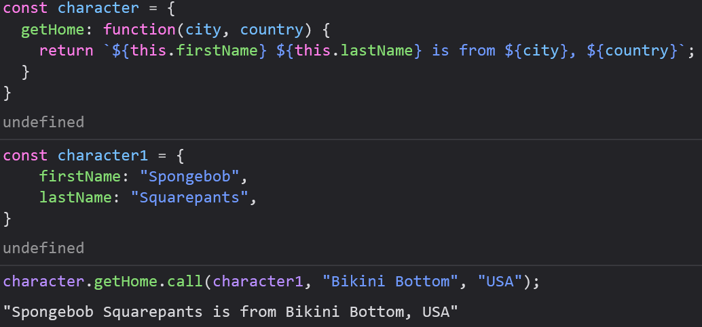
The call() Method with Arguments
The call() method accepts arguments as well

Slide 32
Function Apply

Slide 33
JavaScript’s apply() Method
Just like with call(), apply() can be used to call one object’s method on another object
The difference is that unlike call(), apply() takes its arguments as an array

Slide 34
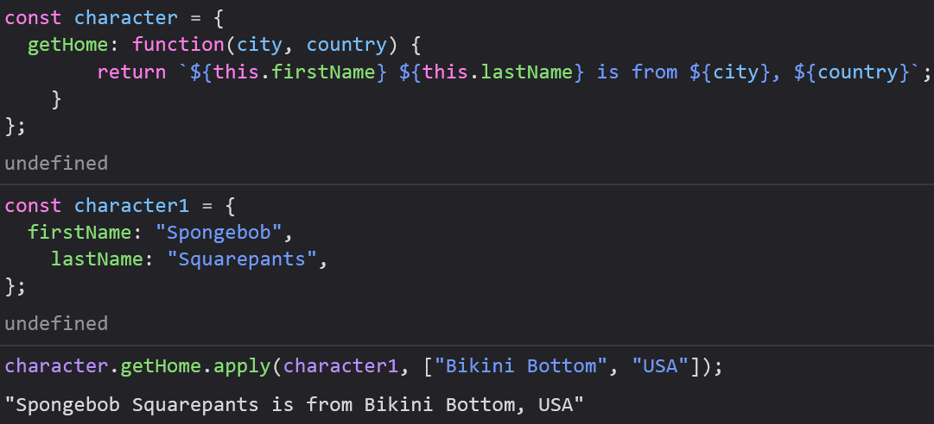
The apply() Method with Arguments
apply() accepts arguments as an array

Slide 35
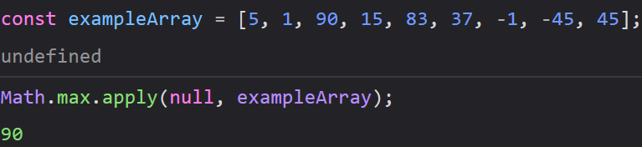
Simulate Methods on Arrays
Sometimes we want to use a method from one object on another object
In the past, we have seen apply() used when we wanted to find the Max of an Array
Since Arrays are objects, we can apply() the Math object’s max() method on our Array

